Slide 1
Unit-1 PIC Microcontroller Architecture Objective: To study architectural details of PIC 18 microcontroller.
By Mr. Bhagwat K.S.(Asst Prof )
Dept of IT

Slide 2
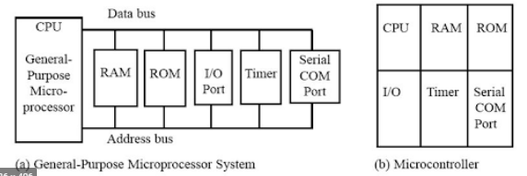
Introduction to Microcontroller
Microprocessor: Intels x86 family(8086,80286,80386,80486 & pentium) are general purpose microprocessors.
MP contain no RAM, no ROM, & no I/O ports on the chip itself. Hence they are referred as general purpose microprocessors.
External RAM, ROM, I/O ports & timers are added in microprocessor to make them functional. But it makes systems bulkier.
A Microcontroller has a CPU in addition to a fixed amount of RAM, ROM, I/O ports, & Timer all on single chip. Hence microcontroller is ideal for many applications.

Slide 3
Applications of Microcontroller:
TV Remote Control, Telephones, Security Systems, Door openers, Answering m/c, Cable TV tuner, Musical instruments, Sewing m/c, lighting control, Camera, Toys, Microwave, Printer, Engine control, Air bag, Climate control.
MC is used for Embedded Systems. Only one app s/w is burned into ROM.
E.g of embedded system is Printer-processor inside performs only one task(i.e getting data & printing it).
Pentium PC- used for any no of applications such as: word processor, n/w server, internet terminal, video game player etc.
PC loads no of s/ws for verity of applications. As it have OS & RAM for loading no of application s/ws.

Slide 4
An x86 PC is connected to various embedded products such as the K/B, Printer, Modem, Disk Controller, Sound Card, Mouse, CD-ROM & so on.
Each one of these has a MC inside it that performs only one task.
E.g mouse MC performs the task of finding the mouse position & sending it to the PC.

Slide 5
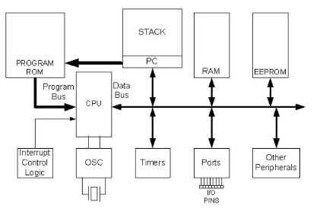
Brief history of microcontrollers
In 1989, Microchip Technology Corporation introduced an 8-bit Microcontroller called the PIC( Peripheral Interface Controller).
It had small amounts of data RAM, a few 100 bytes of on-chip ROM for the program, 1 timer & a few pins for I/O ports, all on a single chip with only 8 pins.(see fig)
Fig: Simplified View of a PIC Microcontroller.

Slide 6
Since the introduction of the PIC16xxx, they have introduced an array of 8-bit MCs too numerous to list here.
They include the PIC families of 10xxx, 12xxx, 14xxx, 16xxx, 17xxx & 18xxx. They all are 8-bit processors (work on 8-bit Data at a time).
Data larger than 8-bits has to be broken into 8-bit pieces to be processed by the CPU.
Problem with PIC- not all 100 % upwardly compatible in terms of software when going from one family to another family.
PIC18xxx(18 to 80-pin) family has the highest performance of all the families of 8-bit PIC MCs.

Slide 7
Difference between Microprocessor and Microcontroller
Parameter | Microprocessor | Microcontroller
Data bus width | 4,8,16,32,& 128 bits | 8,16,32 bits
Memory Addressing capacity | Upto Tera Byte(TB) & can use virtual memory also | Upto 4MB & Each has fixed RAM & ROM
Clock Speed | Variable upto 100MHz | DC -40MHz
Interfacing | Need external chip for interfacing I/O devices. | Inbuilt ports for interfacing of I/O devices.
Architecture | CISC(single Data &Address bus for Dara &Code memory) | CISC &RISC (Separate Data & Address Bus for Data & Code Memory)
Peripherals | CPU is standalone (RAM, ROM, I/O,Timer are connected externally) | CPU RAM,ROM,I/O,Timer are on single chip.
Access time | High | low
cost | High-Multifunctional | Low-single purpose.
Example | 8085,8086, Pentium | Intel 8051, PIC16FXX,PIC18FXX
Application | Word Processing, Internet, App Prog ,windows app development etc | Camera, Washing M/C , Oven etc.

Slide 8
Criteria for selection of Microcontroller
5 major 8-bit Microcontrollers: Motorola 68HC11, Intel’s 8051, Atmel’s AVR, Zilog’s Z8, & PIC from Microchip Technology.
Each of the above MCs has a Unique Instruction Set & Register Set.
Therefore they are not compatible with each other.
Programs written for one will not run on the others.
16-bit, 32-bit MCs made by various chip makers.

Slide 9
Criteria considered by designer for choosing one Microcontroller:
It must meet the task at hand efficiently & cost effectively.
Data handling capacity : Bits, bytes, words, double words, Quad words
Other considerations are:
Speed-depends on clock
Packaging (does it comes in 40-pin DIP (dual inline package)
Power consumption
Amount of on-chip RAM & ROM.
No of I/O pins & the timer on the chip.
Easy of upgrade to higher performance or lower-power-consumption versions.
Cost per unit.
Watchdog timer , timer modes, Data EEPROM

Slide 10
2) How easy it is to develop products around it.
Availability of s/w & h/w development tools:
such as:
compilers,
assemblers,
debuggers &
emulators.
3)Its ready availability & reliable in both now & in future.
i. Motorola, Atmel, Zilog & Microchip technology has massive dedicated resources for supply.
ii. All the products are stable, Matured &single sourced.

Slide 11
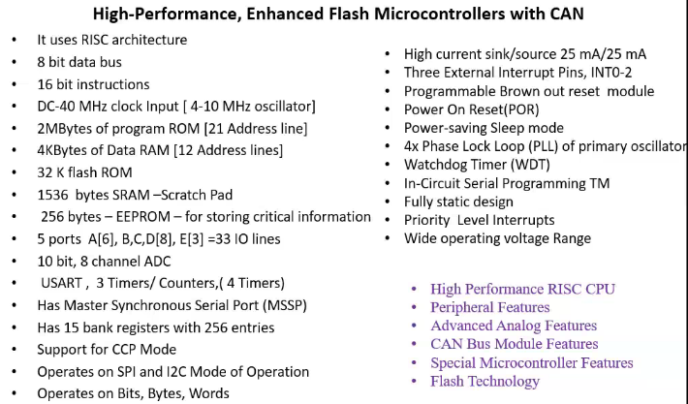
PIC18FXXX: Features and architecture

Slide 12
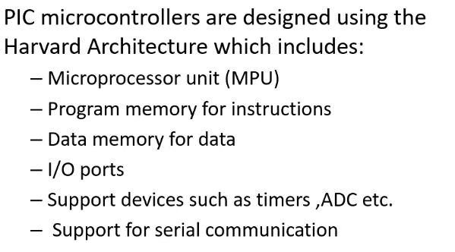
PIC18FXX2 Architecture
PIC18F452 MC is 40 Pin Microcontroller.

Slide 13
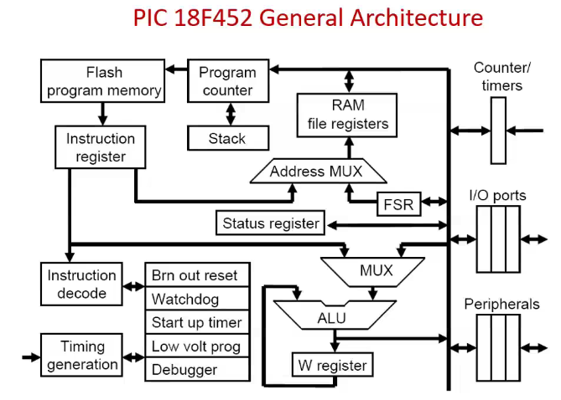

Slide 14
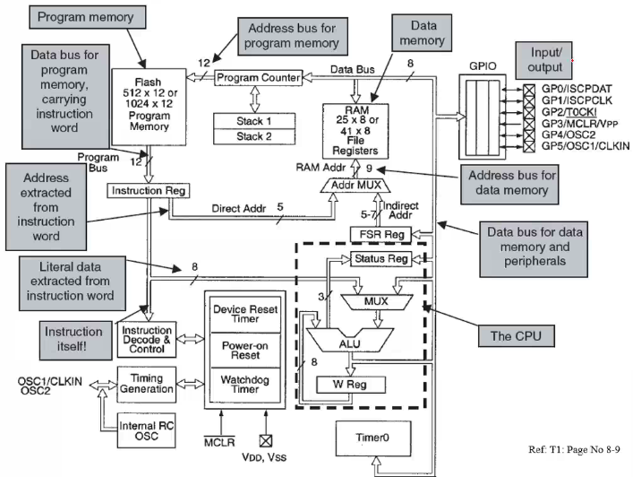

Slide 15
Following fig shows the internal block diagram of the PIC18F452 MC.
CPU is at the center of the diagram & consists of an 8-bit ALU, an 8-bit working accumulator register (WREG), & an 8X8 h/w multiplier.
Status Register-stores flag, Instruction Decoder-decode fetched instruction
Higher & lower byte of a multiplication are stored in two 8-bit registers called PRODH & PRODL resp.
Program Counter(PC-21 bit) & Program Memory are in the upper left portion of the dia.
Program Memory addresses consist of 21 bits, capable of accessing 2Mbytes of program memory locations.
PIC18F452 has only 32Kbytes of Program memory, which requires only 15 bits. The remaining 6 address bits are redundant &not used.

Slide 16
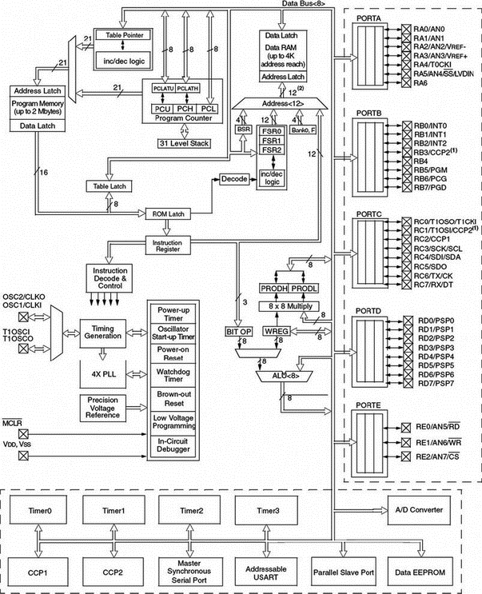
PIC18FXXX Architecture:

Slide 17
A Table Pointer provides access to tables & to the data stored in program memory.
Program Memory contains a 31-level stack which is normally used to store the interrupt & subroutine return addresses.
Data Memory can be seen at the top center of the diagram.
Data Memory bus is 12 bits wide, capable of accessing 4Kbytes of Data memory locations.
Data Memory consists of Special Function Registers (SFR) & General Purpose Registers(GPR), all organized in Banks.

Slide 18
bottom portion of the dia shows the timers/counters, Capture/Compare/PWM registers, USART, A/D converter, & EEPROM data memory.
The PIC18F452 consists of:
4 timers/counters
2 Capture/Compare/PWM modules
2 serial communication modules
8 10-bit A/D converter channels
256 bytes EEPROM
Oscillator circuit, located at the left side of the dia, consists of:
Power-Up timer
Oscillator start-up timer
Power-On Reset
Watchdog timer
Brown-Out Reset
Low-Voltage Programming
In-Circuit Debugger
PLL circuit
Timing Generation circuit

Slide 19
PLL circuit is new to the PIC18F series & provides the option of multiplying up the oscillator frequency to speed up the overall operation.
Watchdog timer can be used to force a restart of the microcontroller in the event of a program crash.
In-circuit debugger is useful during program development & can be used to return diagnostic data, including the register values, as the microcontroller is executing a program.

Slide 20
i/o ports are located at the right side of the diagram.
PIC18F452 has 5 parallel ports named PORTA, PORTB, PORTC, PORTD, and PORTE.
Most port pins have multiple functions. For e.g, PORTA pins can be used as Parallel i/o or Analog inputs.
PORTB pins can be used as parallel i/o or as Interrupt inputs.
Bank Select Register(4 bit)-used in direct addressing the data memory.
File Select Register(16bit)-used as mem pointers in indirect addressing data memory.

Slide 21
The PIC18 Memory Organization
Data Memory & Program Memory are separated.
Hence it makes possible the simultaneous access of data & instruction.
Data Memory(RAM) are used as General-Purpose Registers(GPR) or Special Function Registers(SFR).
On-chip Data EEPROM are provided in some PIC18 MCUs

Slide 22
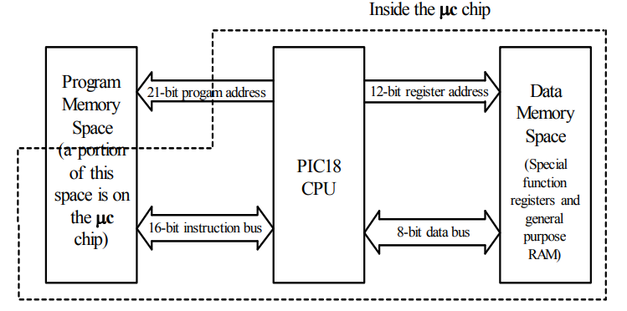
Fig: PIC18 Memory Spaces

Slide 23
PIC18 MC Program ROM:
In PIC18 ROM is used to store programs, hence it is called as Program ROM.
PIC18 has 2M(MegaBytes) of Program ROM space.
Depending on family member size can vary from 4K to 128K.

Slide 24
PIC MC Data RAM & Data EEPROM:
RAM is used for DATA storage.
PIC18 has a max of 4096bytes(4K) of Data RAM space.
It can vary from 256 bytes to 4096 bytes.
Data RAM contain 2 components: GPR,SFR
SFRs are fixed size & GPRs size varies from chip to chip.
RAM GPR space is used for read/write scratch pad & data manipulation & is divided into banks of 256bytes each.
Some PIC18 family members, also have a small amount of EEPROM to store critical data

Slide 25
File Register(RAM) & Access Bank :
File Register(RAM) can have a max of 4096(4K) bytes.
It addresses from 000-FFFH.
File Register is divided into 256-byte banks.
Hence PIC18 have up to max of 16 banks(16X256=4096).
PIC18 family member has at least one bank for the file register.
This bank is called the Access Bank & it is the default bank when we power up the PIC18chip.
Examine the Access Bank for PIC18 in fig:
256-byte Access Bank is divided into 2 equal sections of 128 bytes.
These 128-byte sections are given to GPRs & SFRs.

Slide 26
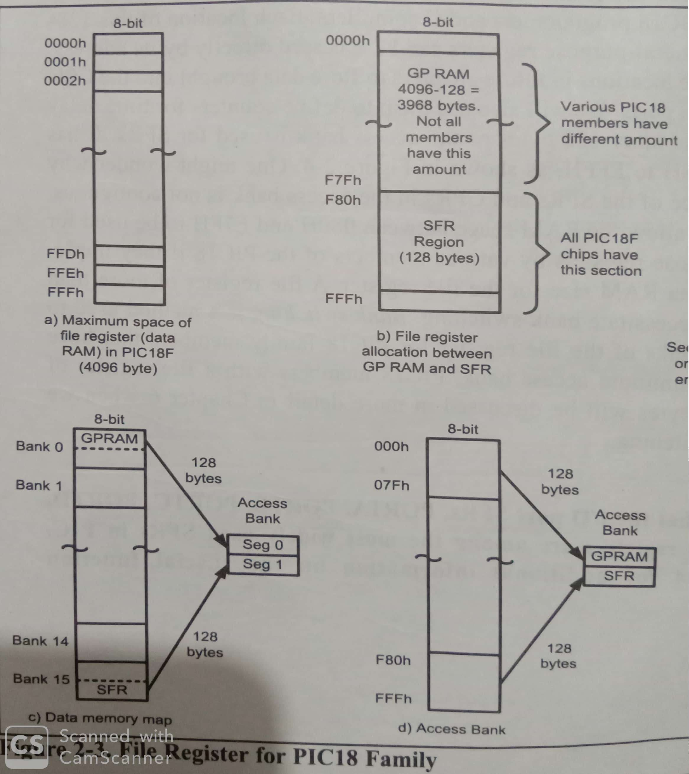

Slide 27
128 bytes from locations 00H to 7FH are set aside for GPR & are used for read/write storage (called scratch pad).
These 128 locations of RAM are widely used for storing data & parameters by PIC18 Programmers & C Compilers.
Each location of this 128-byte RAM of GPR can be accessed directly by its address.
Other 128 bytes of the Access Bank is used for SFRs. It has addresses of F80H to FFFH as shown in fig.

Slide 28
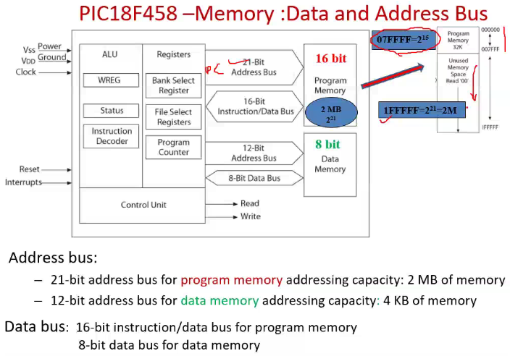

Slide 29
PIC18 MC I/O Pins:
PIC18 can have from 16 to 72 pins dedicated for I/O.
No of I/O pins depends on the no of pins in the package itself.
In PIC18 no of pins goes from 18 to 80 at this time.
In 18-pin PIC18F1220- we have 16 pins for I/O.
In 80-pin PIC18F8722- we can use up to 72 pins for I/O.

Slide 30
PIC18 MC Peripherals
PIC18 family come with ADC(Analog-to-Digital convertor), Timers, & USART(Universal Synchronous Asynchronous Receiver Transmitter) as standard peripherals.
ADC is 10 bit
PIC18 can have 4 timers besides the watchdog timer.
USART peripheral allows us to connect the PIC18 system to serial ports such as the COM port of the IBM PC.
Many of the PIC18 members come with the I^2.C & CAN bus as well.

Slide 31
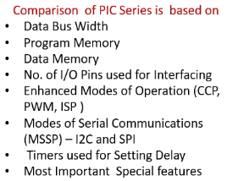
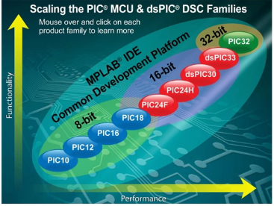
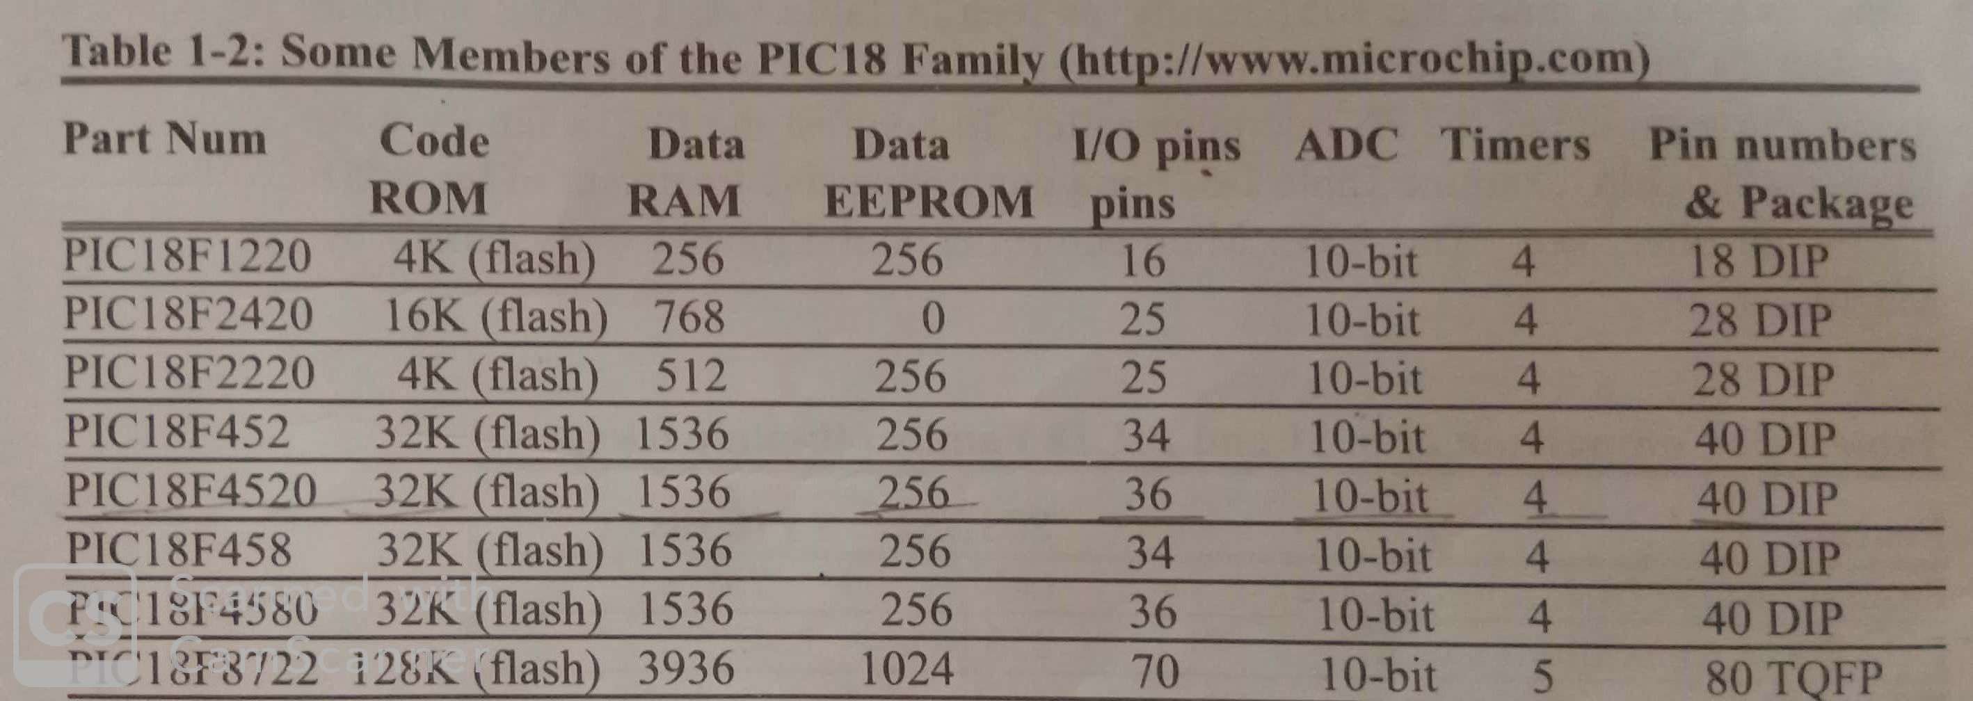
comparison of PIC 18 series microcontrollers

Slide 32
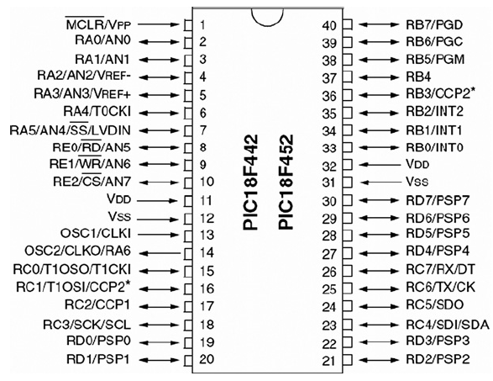
PIC18F458/452 Pin out connection
VSS,VDD-Speed of Operation
OSC-Oscillator clock
1. TRISX =0 ( O/P) , =1 ( I/P) ; 2. PORTX; 3. LATX X= A,B,C,D,E
Fig PIC18F452 Pinout

Slide 33
PIC18F452 is an 8-bit with 10 MIPS, CMPS, FLASH-based MC
It has 34 I/O pins out of 40 Pin packages.
It is a powerful MC with one 8-bit & three 16-bit timers, 8-Channels 10-bit Analog-digital converter, & I2C, SPI, USART peripheral.
It is a Low power MC unit that consumes about less than 0.2 uA standby current and 1.6mA normal current during 5V & 4 Mhz operations.

Slide 34
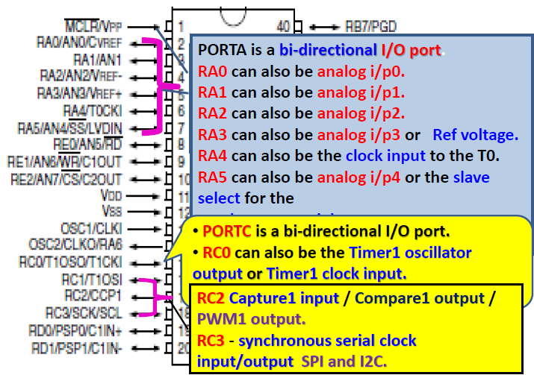

Slide 35
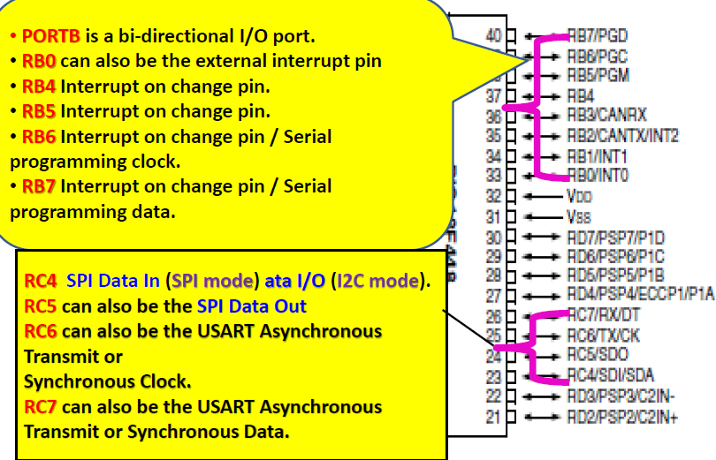

Slide 36
PIC18F452 Pin Configuration
Pin Number | Pin Name | Description
1 | MCLR/VPP | Master Clear (input) or High voltage ICSP programming enable pin mainly used for programming purposes.
2 | RA0/AN0 | Bidirectional I/O pin of Port A bit 0 or Analog input 0
3 | RA1/AN1 | Bidirectional I/O pin of Port A bit 1 or Analog input 1
4 | RA2/AN2/VREF- | Bidirectional I/O pin of Port A bit 2 or Analog input 2 or A/D Reference (Low) Voltage.
5 | RA3/AN3/VREF+ | Bidirectional I/O pin of Port A bit 3 or Analog input 3 or A/D Reference (High) Voltage.
6 | RA4/T0CKI | Bidirectional I/O pin of Port A bit 4 or Timer 0 external clock input.
7 | RA5/AN4/SS/LVDIN | Bidirectional I/O pin of Port A bit 5 or Analog input 4 or SPI Slave Select input or Low voltage Detect input.

Slide 37
Pin Number | Pin Name | Description
8 | RE0/RD/AN5 | Bidirectional I/O pin of Port E bit 0 or Read control for parallel slave port or Analog input 5
9 | RE1/WR/AN6 | Bidirectional I/O pin of Port E bit 1 or Write control for parallel slave port or Analog input 6
10 | RE2/CS/AN7 | Bidirectional I/O pin of Port E bit 2 or Chip select control for parallel slave port or Analog input 7.
11 | VSS | Positive supply pin.
12 | VDD | Ground supply pin.
13 | OSC1/CLKI | Oscillator Crystal or External clock input.
14 | OSC2/CLKO/RA6 | Bidirectional I/O pin of Port A bit 6 or Oscillator crystal or clock output.
15 | RC0/T1OSO/T1CKI | Bidirectional I/O pin of Port C bit 0 or Timer 1 Oscillator output or Timer 1/Timer 3 external clock input.

Slide 38
Pin Number | Pin Name | Description
16 | RC1/T1OSI/CCP2 | Bidirectional I/O pin of Port C bit 1 or Timer 1 Oscillator input or Capture 2 input, Capture 2 output, PWM 2 output.
17 | RC2/CCP1 | Bidirectional I/O pin of Port C bit 2 or Capture 1 input, Capture1 output, PWM1 output
18 | RC3/SCK/SCL | Bidirectional I/O pin of Port C bit 3 or Synchronous serial clock input/output for SPI mode or Synchronous serial clock input/output for 12C mode.
19 | RD0/PSP0 | Bidirectional I/O pin of Port D bit 0 or Parallel slave Port Data
20 | RD1/PSP1 | Bidirectional I/O pin of Port D bit 1 or Parallel slave Port Data.
21 | RD2/PSP2 | Bidirectional I/O pin of Port D bit 2 or Parallel slave Port Data
22 | RD3/PSP3 | Bidirectional I/O pin of Port D bit 3 or Parallel slave Port Data

Slide 39
Pin Number | Pin Name | Description
23 | RC4/SDI/SDA | Bidirectional I/O pin of Port C bit 4 or SPI Data In or 12C data I/O.
24 | RC5/SDO | Bidirectional I/O pin of Port C bit 5 or SPI Data Out.
25 | RC6/TX/CK | Bidirectional I/O pin of Port C bit 6 or USART Asynchronous Transmit or USART Synchronous Clock
26 | RC7/RX/DT | Bidirectional I/O pin of Port C bit 7 or USART Asynchronous Receive or USART Synchronous Data
27 | RD4/PSP4 | Bidirectional I/O pin of Port D bit 4 or Parallel slave Port Data
23 | RC4/SDI/SDA | Bidirectional I/O pin of Port C bit 4 or SPI Data In or 12C data I/O.
24 | RC5/SDO | Bidirectional I/O pin of Port C bit 5 or SPI Data Out.

Slide 40
Pin Number | Pin Name | Description
25 | RC6/TX/CK | Bidirectional I/O pin of Port C bit 6 or USART Asynchronous Transmit or USART Synchronous Clock
26 | RC7/RX/DT | Bidirectional I/O pin of Port C bit 7 or USART Asynchronous Receive or USART Synchronous Data
27 | RD4/PSP4 | Bidirectional I/O pin of Port D bit 4 or Parallel slave Port Data
28 | RD5/PSP5 | Bidirectional I/O pin of Port D bit 5 or Parallel slave Port Data
29 | RD6/PSP6 | Bidirectional I/O pin of Port D bit 6 or Parallel slave Port Data
30 | RD7/PSP7 | Bidirectional I/O pin of Port D bit 7 or Parallel slave Port Data
31 | VSS | Ground Supply pin
32 | VDD | Positive supply pin
33 | RB0/INT0 | Bidirectional I/O pin of Port B bit 0 or External Interrupt 0.

Slide 41
Pin Number | Pin Name | Description
34 | RB1/INT1 | Bidirectional I/O pin of Port B bit 1 or External Interrupt 1.
35 | RB2/INT2 | Bidirectional I/O pin of Port B bit 2 or External Interrupt 2.
36 | RB3/CCP2 | Bidirectional I/O pin of Port B bit 3 or Capture 2 input, Compare 2 output, PWM 2 output.
37 | RB4 | Bidirectional I/O pin of Port B bit 4 with IOC (Interrupt-on-change)
38 | RB5/PGN | Bidirectional I/O pin of Port B bit 5 with IOC (Interrupt-on-change) or Low Voltage ICSP programming enable pin
39 | RB6/PG | Bidirectional I/O pin of Port B bit 6 with IOC (Interrupt-on-change) or In-Circuit Debugger and ICSP programming clock pin.
40 | RB7/PGD | Bidirectional I/O pin of Port B bit 7 with IOC (Interrupt-on-change) or In-Circuit Debugger and ICSP programming data pin.

Slide 42
Registers of PIC18F
CPU use many registers to store Data temporarily.
To program in assembly language, we must understand the registers & architecture of a given CPU & the role they play in processing data.
Microprocessor Unit:
It includes ALU, Registers & Control Unit.
PIC MCs have many registers for Arithmetic & Logic operations.
Registers: WREG(Working Register), GPR(General Purpose Registers), SFR(Special Function Registers).

Slide 43
a) WREG ( Working Register):
WREG in CPU is used to store information(byte of data or address pointing to data) temporarily.
It is 8-bit register as shown in fig below.
With an 8-bit data type, any data larger than 8-bits must be broken into 8-bit chunks before it is processed.
WREG-is the same as the Accumulator in other MPs.
It is used to store Result of Arithmetic & Logical operations performed by CPU.
e.g ADDLW 34H ;add value 34 to W(W=W+34H)
D7 (MSB) | D6 | D5 | D4 | D3 | D2 | D1 | D0 (LSB)

Slide 44
b) Data RAM(File Register) Space :
Read/Write memory used by CPU for Data storage, Scratch Pad & registers for internal use & functions.
We can perform Arithmetic & logic operations on many locations of the file register Data RAM.
Size ranges from 32 bytes to several thousand bytes
Size of Data RAM varies from chip to chip.
File register Data RAM in PIC divided into 2 sections:
1) Special-Function Registers(SFR), 2) General-Purpose Registers(GPR)

Slide 45
1) Special-Function Registers(SFR)
It is used for functions such as ALU status, timers, Serial Communication, I/O ports, ADC, & so on.
The function of each SFR is fixed by the CPU designer at the time of design.
Because it is used for control of the microcontroller or peripheral.
PIC SFRs are 8-bit registers.
No of locations in the file register(Data RAM) set aside for SFR depends on the pin numbers & peripheral functions supported by that chip.
Number can vary from chip to chip.

Slide 46
2) General Purpose Registers or RAM:
GPR (RAM locations) in the file register that are used for Data storage & Scratch pad.
Each location is 8 bits wide & can be used to store any Data we want as long as it is 8-bit.
The no of RAM locations in the file register that are set aside for GPR can vary from chip to chip
Space that is not allocated to the SFRs typically is used for GPRs.
In PIC up to 100 bytes are used for SFRs & rest are used for GPRs.
Today's MC contain thousand bytes of GPR , as C compilers need a large GPR.

Slide 47
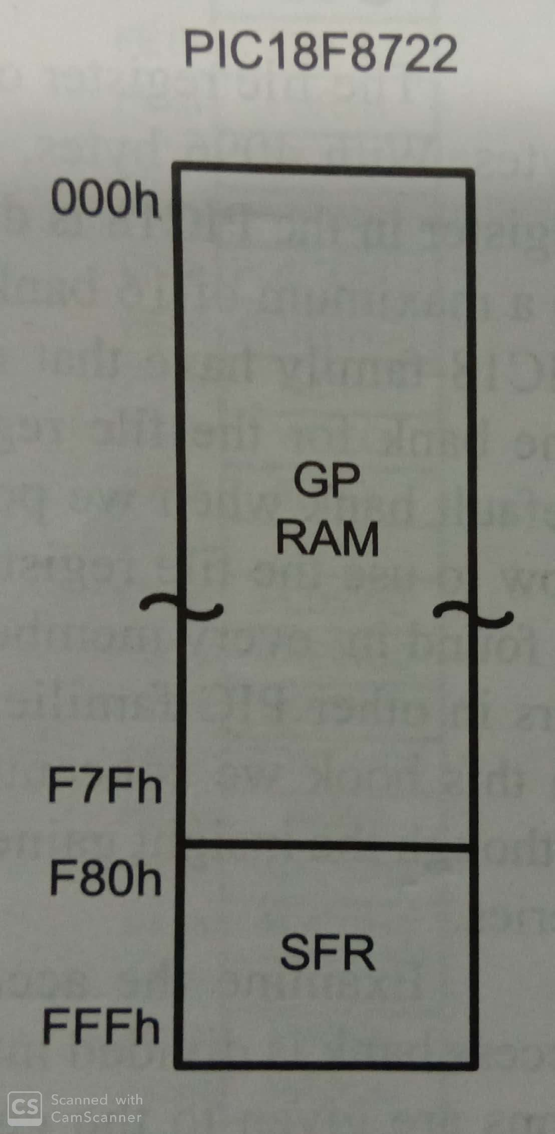
 | File Register(Bytes) | SFR(Bytes) | Available space for GPR(Bytes)
PIC18F8722 | 4096 (4K) | 158 | 3938
Fig: File Registers(RAM) of PIC18

Slide 48
c) Program Counter(PC) register in the PIC18
PC is important register in PIC18 MC.
It is used by the CPU to point to the address of the next instruction to be executed.
As CPU fetches the opcode from the program ROM, the PC is incremented automatically to point to the next instruction.
Wider the PC, more the memory locations a CPU can access.
i.e 14 bit PC can access a MAX of 16K of code from addresses 0000-3FFFH.

Slide 49
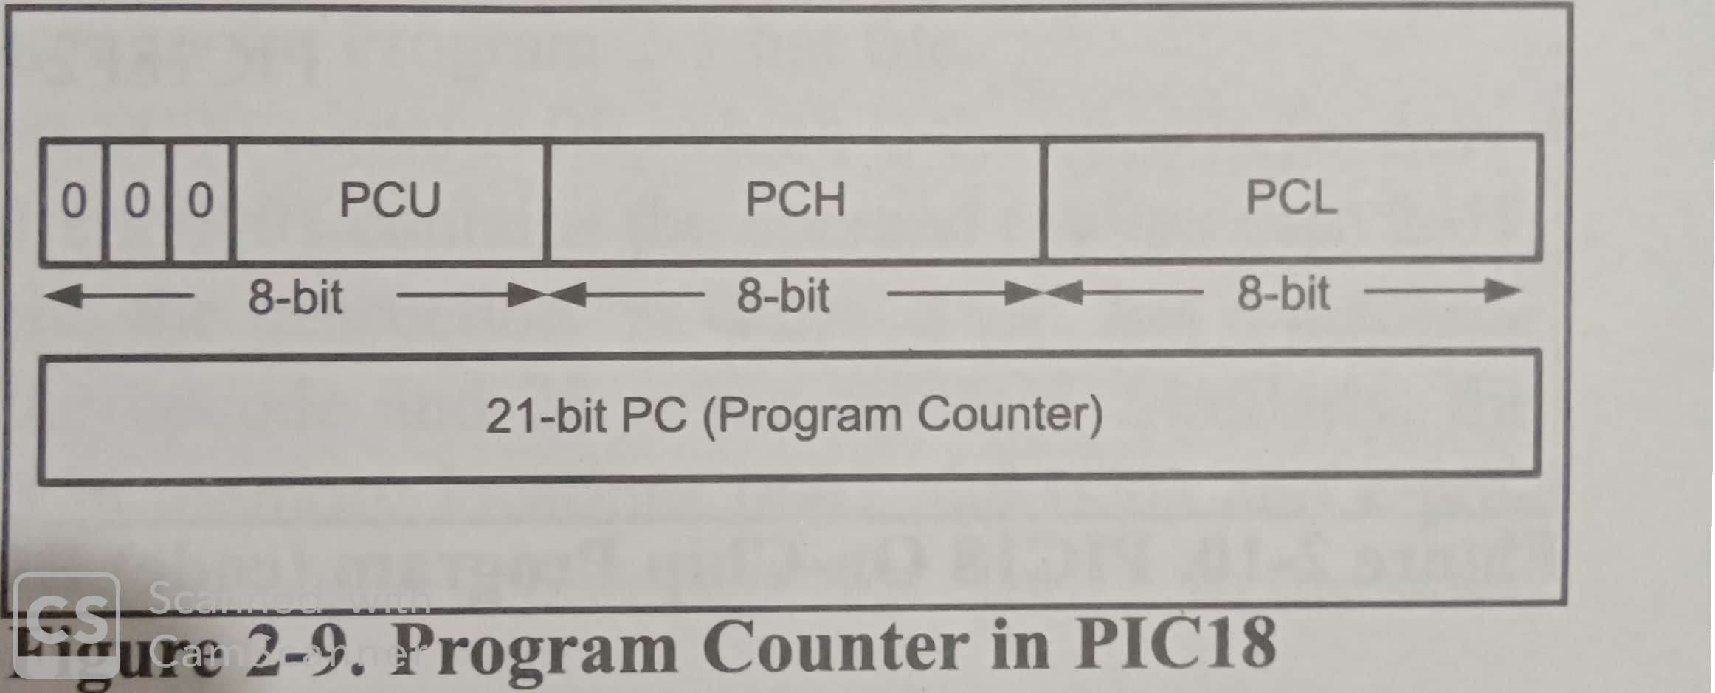
PC in the PIC18 family is 21-bit & it can access program addresses 000000 to 1FFFFFH.
Following fig shows Program Counter in PIC18:

Slide 50
d) Programmable ROM space in the PIC18
PIC18F6680 have 64 K of on chip ROM.
PIC18F458 have 32 K of on chip ROM.
No member of the PIC family can access more than 2M of opcode because the PC in the PIC is 21 bits wide (000000 to 1FFFFF address range).
1st location of program ROM is 000000, the last location can be different depending on the size of the ROM on the chip (see fig ).
PIC18F2220 has 4K of on-chip ROM & its memory addresses of 00000 to 000FFFH
Therefore 1st location of ROM is address 000000 & last location is 0FFFFH

Slide 51
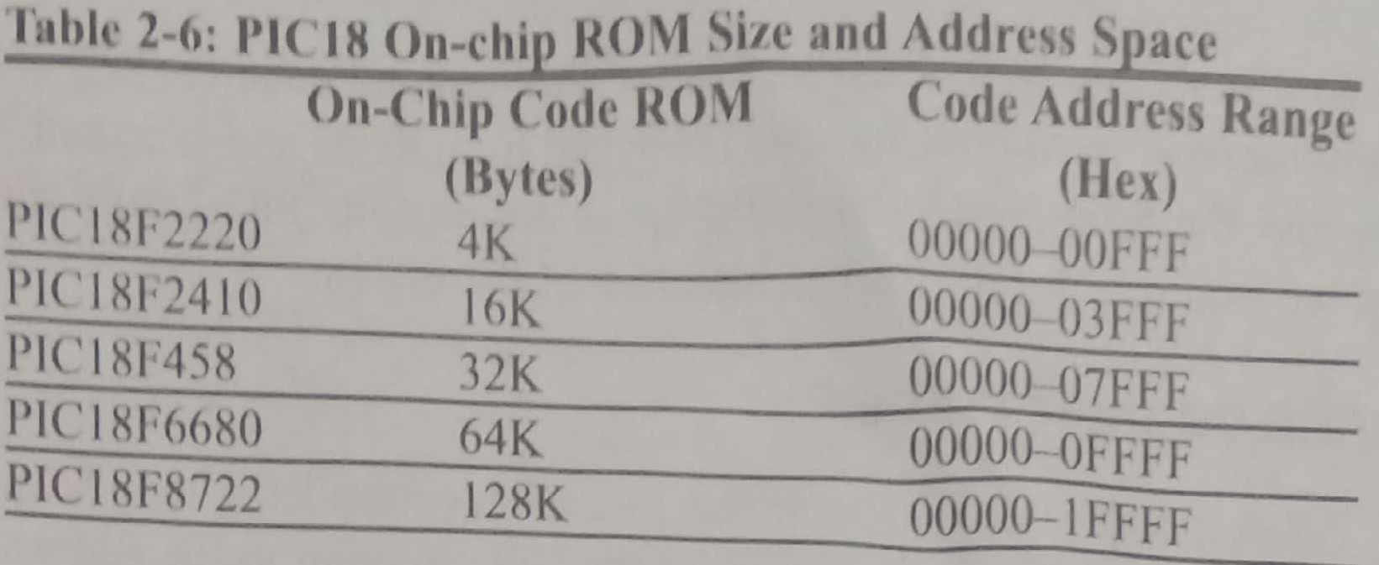
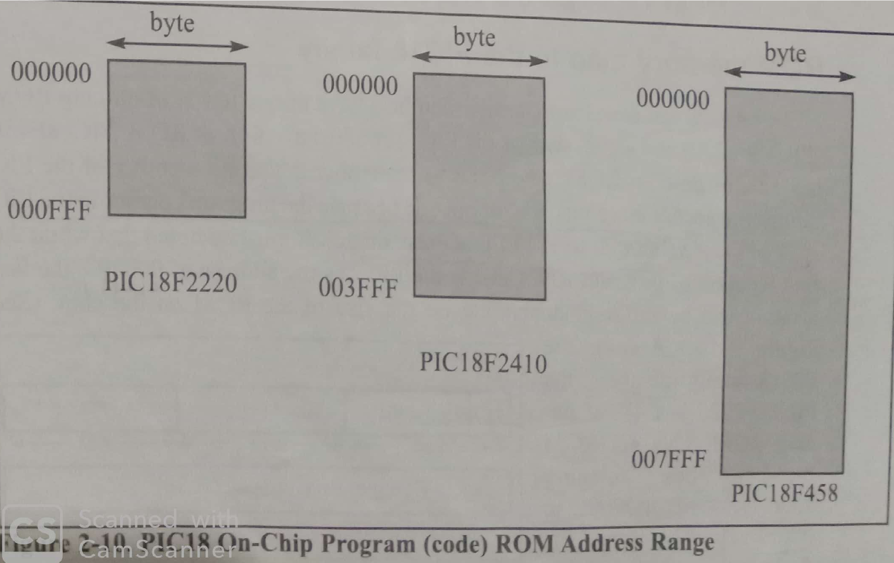

Slide 52
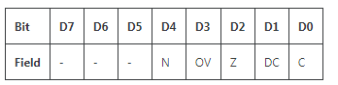
e) PIC18 Status Register
PIC has a Flag Register(8-bit) to indicate Arithmetic conditions such as the Carry bit.
Flag Register in the PIC is called the Status Register.
fig: Bits of Status Register
Out of 8-bits, only 5 bits are used by the PIC18. remaining 3 bits are unimplemented & read as 0.

Slide 53
5 flags are called conditional flag is as follows. They indicate some conditions that result after an instruction is executed.
C – Carry flag
DC – Digital Carry Flag
Z – Zero flag
OV – Overflow Flag
N – Negative flag
X – D5,D6, & D7 are not implemented, & reserved for future use.
Each of the Conditional Flags can be used to perform a Conditional branch(jump).

Slide 54
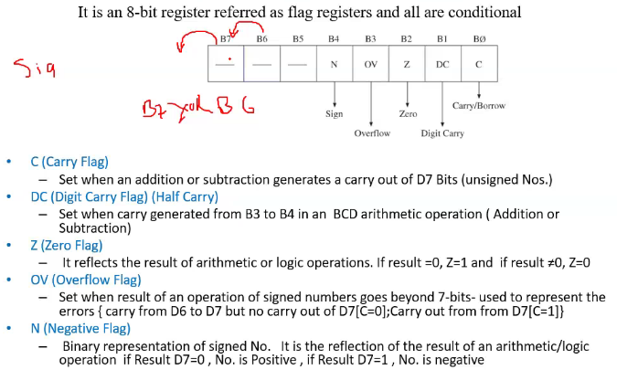

Slide 55
f) Stack Pointer (SP)
Stack is read/write memory(RAM) used by the CPU to store some very critical information(address, Data) temporarily.
Stack is 21-bit because the PC is 21-bit.
It is used for the CALL instruction to make sure that the PIC knows where to come back to after execution of the called subroutine.
A 21-bit stack can take values of 00000 to 1FFFFFH.
Stack is RAM & SP Register is used to access the Stack.

Slide 56
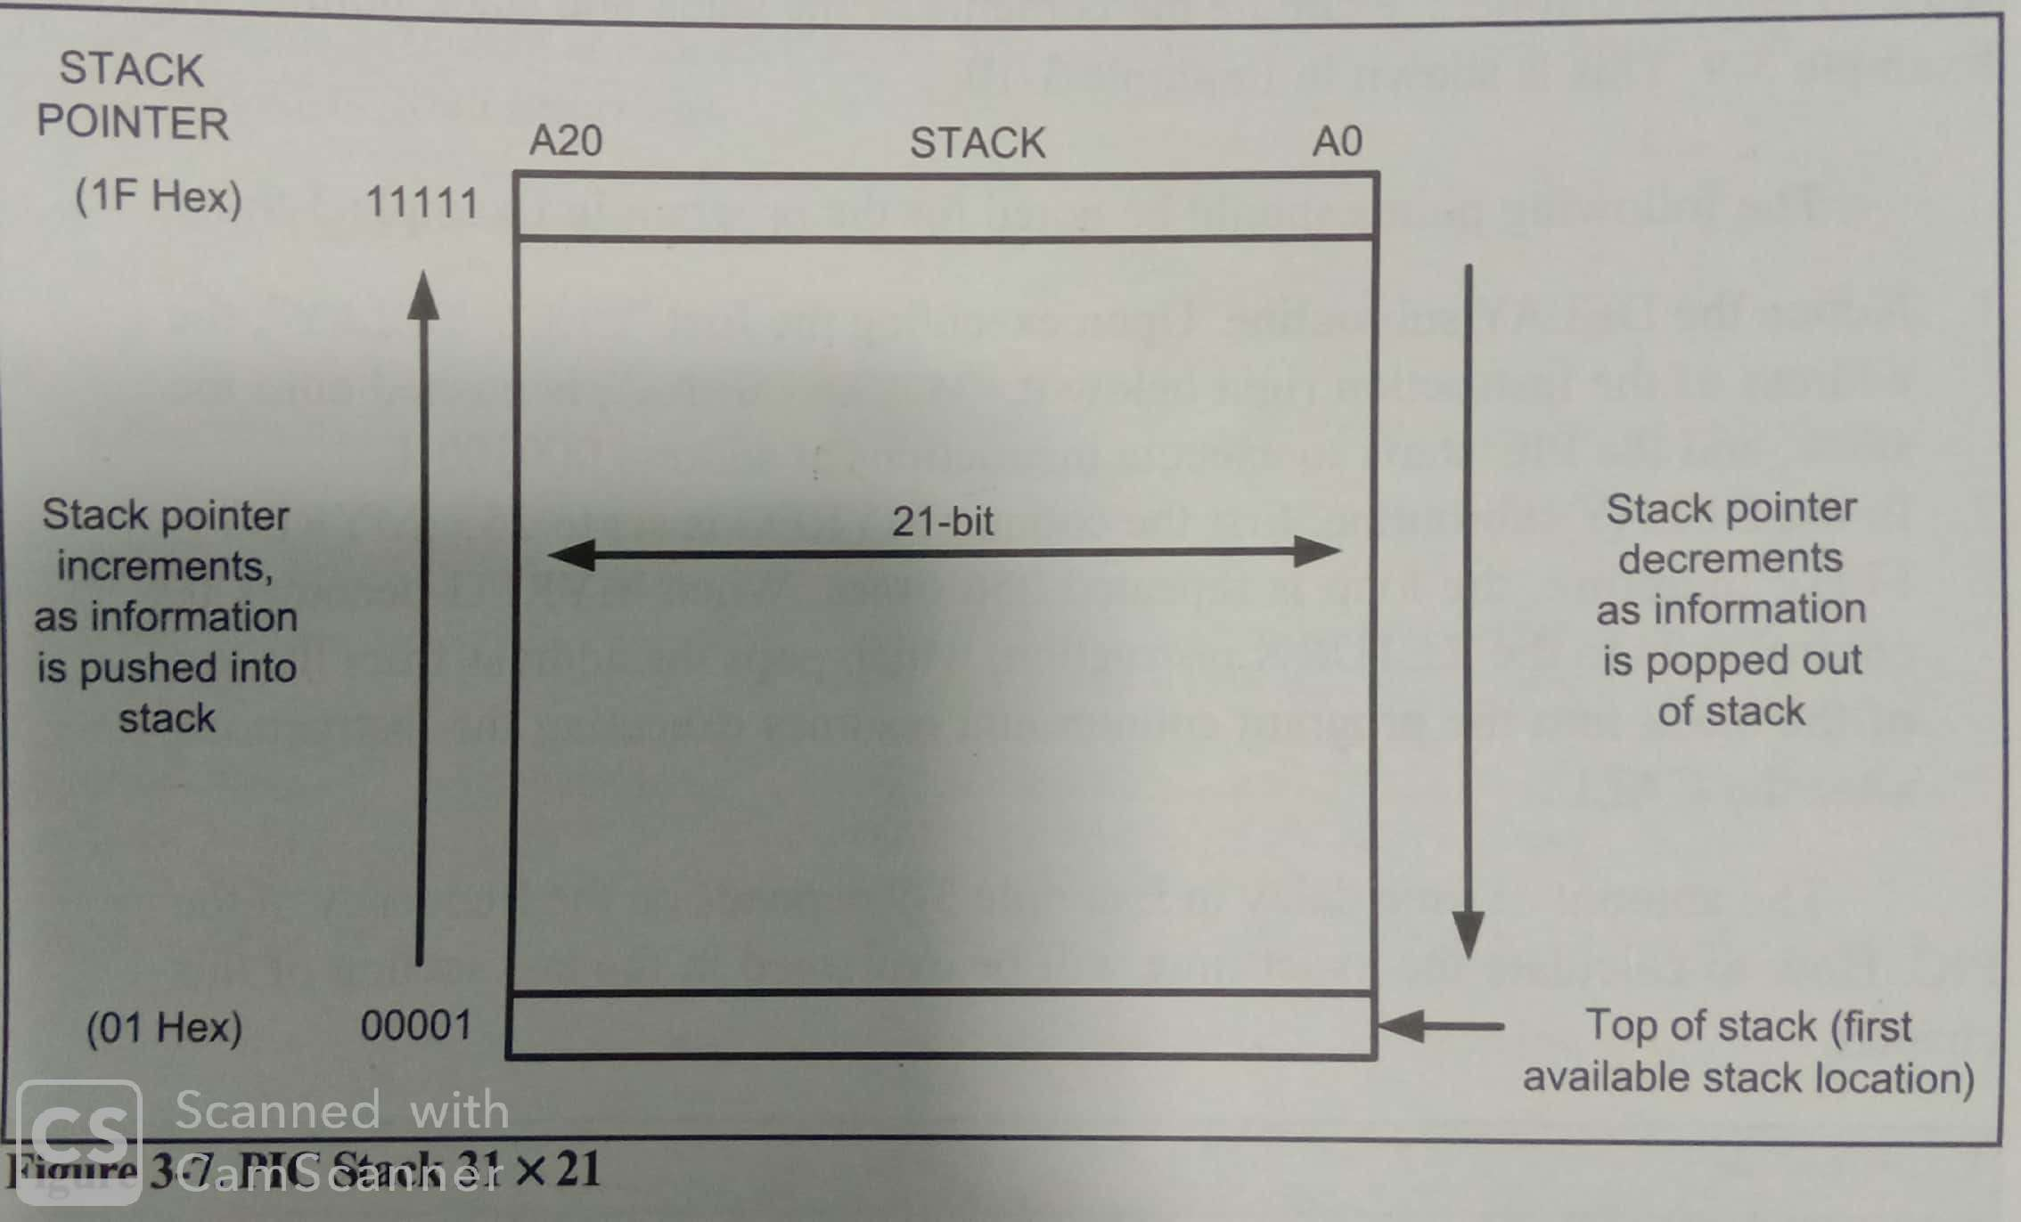
PIC18 has a 5-bit stack pointer, which can take values of 00 to 1FH.
That gives us a total of 32 locations where each location is 21 bits wide. This is shown in fig.

Slide 57
When the PIC18 is powered up, the SP Register contains value 0.
This means that stack location 1 is the 1st location used for the stack because the SP points to the last-used location.
i.e location 0 of the stack is not available & we have only 31 stack locations in the PIC18.

Slide 58
Bank switching in PIC18
PIC18 MC- has a max of Data RAM (4K)
PIC18 family has at least the Access Bank for the file register(RAM).
File register RAM is divided into 16 banks of 256 bytes each.
Minimum Bank is called the Access Bank.
Access bank is made of 128 bytes of lower addresses & 128 bytes of higher addresses.
Lower 128 bytes( 000-07FH)are used for GPR, the higher 128 bytes(F80-FFFH) are dedicated to the SFRs.

Slide 59
The A bit & Bank Switching:
All the instructions assumed the Access Bank as the default bank.
This was achieved by ignoring the letter A in instructions such as “MOVF fileReg, A”. i.e “MOVF fileReg” is really “MOVF fileReg, A” where A bit can be 0 or 1.
If A=0, then the Access bank is the default bank.
If A=1, then the instruction will use the Bank Selector register(BSR) to select the bank instead of using the Access Bank.
If A is not stated in a given instruction, it means A=0 & Access Bank is the default bank.

Slide 60
BSR Register & Bank Switching:
To use banks other than the Access Bank, we need to set bit A=1 in the instruction.
With A=1, we use the BSR to choose the desired bank.
BSR(8-bit) register is part of the SFRs.
BSR(8-bit), containing only 4 least-significant bits are used in the PIC18. The upper 4 bits are set to 0 & are ignored by the PIC18.
BSR(4 bit) gives us 16 banks, & it cover the entire 4096(16X256)bytes of the data RAM file register using bank switching.
Data RAM(4096 bytes) are organized as banks 0 to F, where lowest bank0(00-FFH) & highest bank is BankF(F00-FFFH).

Slide 61
128 bytes of bank F(15) are always set aside for the SFRs, while GPR always start at address 0 of bank0.
Upon Power-On Reset, BSR=0(0000 binary), then the lowest addresses of data RAM, from 000 to 0FFH can be used for the GPR & the SFRs, which always reside in the last half of bank F(15).
Llly, if BSR=1(0001 binary), then PIC18 selects bank1 in addition to the SFRs. (last half bank with addresses of F80-FFFH).
If BSR with value 02(0010 binary), which allows access to the bank2 in addition to the SFR
GPR always starts at address 000 & goes up. SFR start at the other end of the 4KB at address FFF, & come down (F80H-FFFH)

Slide 62
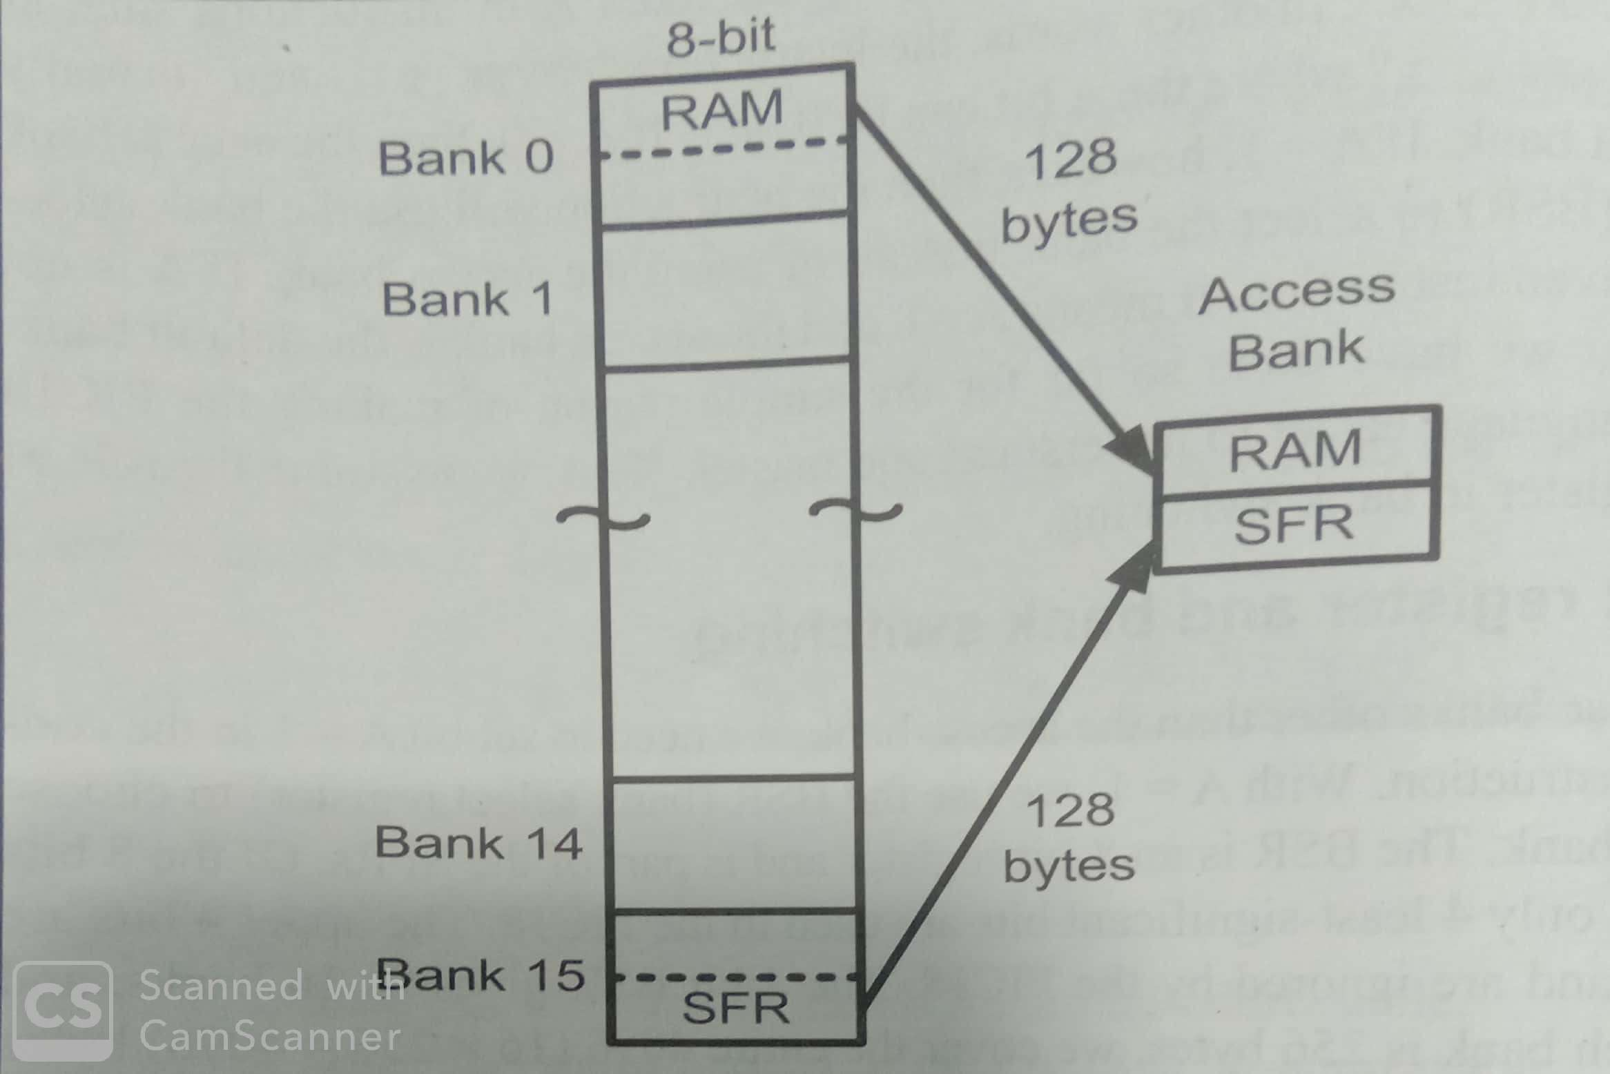
Fig Data RAM Registers

Slide 63
Addressing modes with instruction example
CPU can access data in various ways.
Data could be in a Register, or in Memory, or Immediate value.
Theses various ways of accessing data are called addressing modes.
In PIC18 provide 4 addressing modes:
1.Immediate
2.Direct
3.Register Indirect
4.Indexed-ROM

Slide 64
1) Immediate Addressing Mode:
Operand is a literal constant.
Operand comes immediately after the Opcode when the instruction is assembled
Immediate Data is called a literal in the PIC.
This addressing mode can be used to load information into WREG & selected registers, but not to any file register.
Used in Arithmetic & logic instructions.
E.g
MOVLW 0x25 ; load 25H into WREG
SUBLW D’62’ ; subtract WREG from 62
ANDLW B’01000000’ ; AND WREG with 40H

Slide 65
2)Direct Addressing Mode:
256-byte Access Bank file register is split into 2 sections: lower(00 to 7FH) are assigned for GPR & Upper (F80-FFFH) are assigned to SFR.
Access Bank is the default bank when PIC18 is powered up.
Data RAM file register can be accessed using either Direct or Register indirect addressing modes.
In Direct addressing mode, the Operand data is in a RAM memory location whose address is known, & this address is given as a part of the instruction.

Slide 66
In Immediate addressing mode, Operand data provided in instruction. Letter ‘L’ in the instruction means literal (immediate),
The letter ‘F’ in the instruction signifies the address of the file register location.
E.g
Immediate Addressing Mode e.g:
MOVLW 0x56 ;WREG=56H
Direct Addressing Mode e.g:
MOVWF 0x40 ;copy WREG into fileReg RAM location 40H
MOVFF 0x40,0x50 ;copy data from location 40H to 50H.

Slide 67
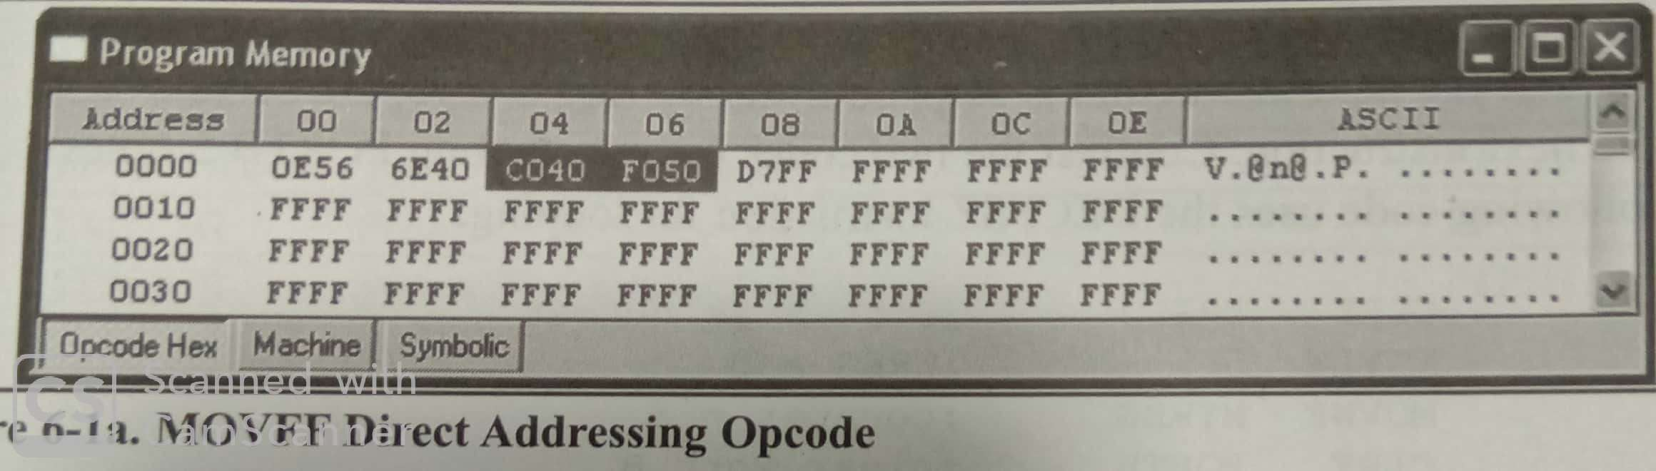

Slide 68
3.Register Indirect
A register is used as a pointer to the data RAM location.
In PIC18, 3 File Select Registers are used for this purpose: FSR0, FSR1, & FSR2
FSR is 12-bit register allowing access to the entire 4096 bytes of Data RAM space.
We use LFSR (Load FSR) to load the RAM address.
LFSR0, 0x30 ;load FSR0 with 0x30
LFSR1, 0x40 ;load FSR1 with 0x40
LFSR2, 0x6F ;load FSR2 with 0x6F

Slide 69
FSR registers have the low-byte(FSRxL is 4-bit) & high byte(FSRxH is 4-bit) parts. E.g FSR0L & FSR0H.
INDF(Indirect register) is another register is associated with register indirect addressing mode.
FSR0,FSR1,& FSR2 registers has an INDF register associated with it,& these are called INDF0,INDF1,&INDF2.
When we move data into INDFx we are moving data into a RAM location pointed to by the FSR.
LFSR0,0x30 ;FSR0=30H RAM location pointer
MOVWF INDF0 ; copy contents of WREG into RAM location whose address is held by 12-bit FSR0 register.

Slide 70
4. Indexed ROM addressing mode:
This addressing mode is used for accessing the data from look up tables that reside in the PIC18 program ROM.

Slide 71
Oscillator configurations
The Oscillator circuit, located at the left side of the diagram, consists of:
Power-Up Timer
Oscillator Start-up Timer
Power-on Reset
Watchdog Timer
Brown-Out Reset
Low-voltage Programming
In-circuit Debugger
PLL Circuit
Timing Generation Circuit

Slide 72
PLL circuit is new to the PIC18F series & provides the option of multiplying up the oscillator frequency to speed up the overall operation.
Watchdog timer can be used to force a restart of the microcontroller in the event of a program crash.
In-Circuit Debugger is useful during program development & can be used to return diagnostic data, including the register values, as the microcontroller is executing a program.

Slide 73
Reset operations
Reset action puts the MC into a known state.
Resetting a PIC18F MC starts execution of the program from address 0000H of the program memory.
The Microcontroller can be Reset during one of the following operations:
-Power-on Reset (POR)
- MCLR Reset
- Watchdog Timer (WDT) Reset
- Brown-out Reset (BOR)
- Reset Instruction

Slide 74
-Stack full Reset
-Stack Underflow Reset
2 types of Resets are commonly used: Power-on Reset & External Reset using the MCLR pin.
Power-on Reset :
It is generated automatically when power supply voltage is applied to the chip.
MCLR pin should be tied to the Supply voltage directly or, preferably, through a 10K Resistor.
Figure 2.11 shows a typical reset circuit.

Slide 75
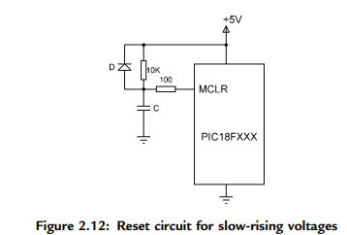
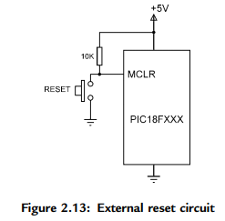
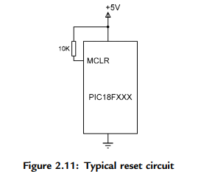
For applications where the rise time of the voltage is slow, it is recommended to use a diode, a capacitor, & a series resistor as shown in Figure 2.12.
In some applications the MC may have to be reset externally by pressing a button.
Figure 2.13 shows the circuit that can be used to reset the MC externally.
Normally the MCLR input is at logic 1. When the RESET button is pressed, this pin goes to logic 0 & resets the microcontroller.

Slide 76
Brownout reset
PIC18FXXX devices have a built-in Brown-Out Reset (BOR) feature that resets the device when the supply voltage drops too low.
BOR is used to insure that the device will not try to run at a voltage that is too low for correct operation.
Designer should insure that the device normally operates above the Brown-Out Reset trip point with some margin for error.
Brown-Out Reset is not a substitute for a proper Power-On Reset.

Slide 77
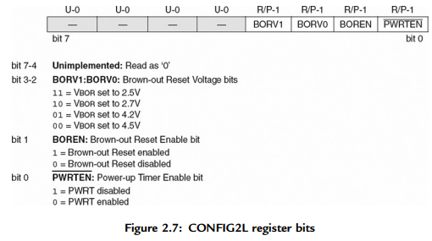
CONFIG2L
The CONFIG2L configuration register is at address 300002H & is used to select the brown-out voltage bits. The bit patterns are shown in Figure 2.7.

Slide 78
Watchdog timer
In PIC18FXXX-have a watchdog timer (WDT) is a free running on-chip RC-based oscillator & does not require any external components.
When the WDT times out, a device RESET is generated.
If the device is in SLEEP mode, the WDT time-out will wake it up & continue with normal operation.
Watchdog is enabled/disabled by bit SWDTEN of register WDTCON. Setting SWDTEN = 1 Enables the WDT, & (0)clearing this bit turns off the WDT.
On the PIC18F452 MC an 8-bit postscaler is used to multiply the basic time-out period from 1 to 128 in powers of 2.
This postscaler is controlled from configuration register CONFIG2H. The typical basic WDT time-out period is 18ms for a postscaler value of 1.

Slide 79
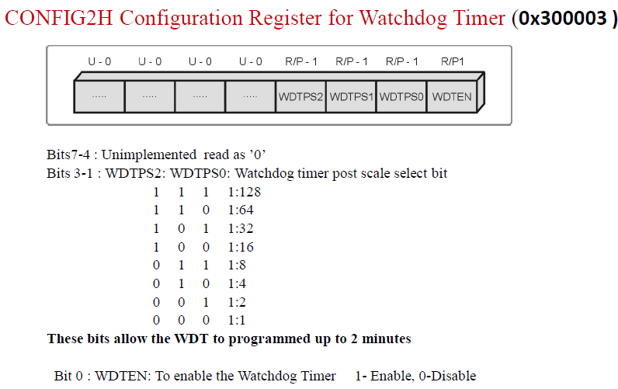

Slide 80
Power Down Modes & Configuration registers.
Power Management Features
Run: CPU on, Peripherals on
Idle: CPU off, Peripherals on
Sleep: CPU off, Peripherals off
PIC18 has a Power-Down Mode to reduce power consumption when the microcontroller is idle.
Most of the applications like Mobile phones, Laptops rely on sleep mode which suspends most or all microcontroller operations to minimize power consumption.
Sleep Mode is necessary for such applications because these are battery-operated devices which help to consume less energy.

Slide 81
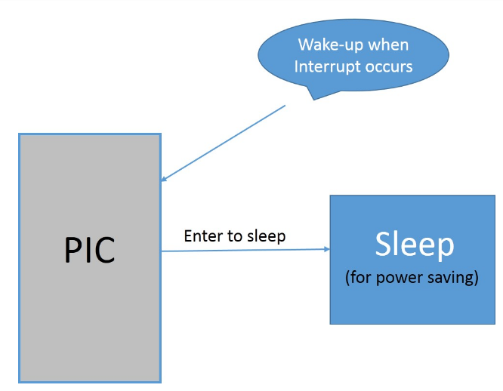
Fig: Concept of Sleep mode
In PIC18F4550 Sleep Mode, the device Oscillator is turned off.
So No System Clocks are occurring in the device. This keeps the PIC in a low power consumption state.

Slide 82
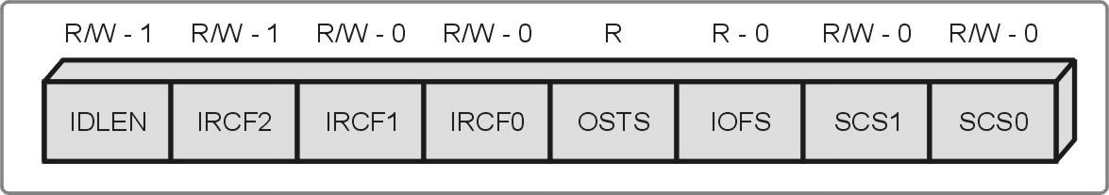
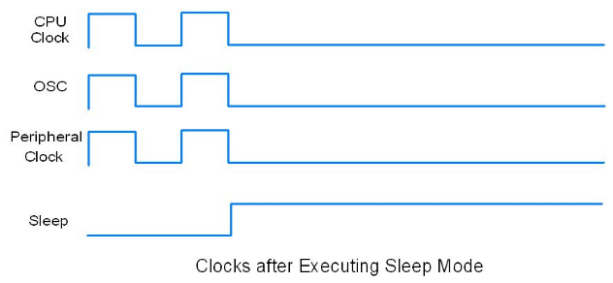
Enter PIC18F4550 in Sleep Mode:
To enter the PIC18F4550 in Sleep mode,
1. Clear the IDLEN bit in the OSCCON Register.
Bit IDLEN:
0 = enable sleep mode
1 = enable idle mode
2. And Execute the SLEEP instruction.
This halts all the Clocks & Oscillator as shown below

Slide 83
If WDT (Watchdog Timer) is enabled then INTRC Source having a frequency of 31 kHz is enabled.
If the Timer1 oscillator is enabled it will also continue to run.
Wake-up PIC18F4550 from Sleep Mode
PIC18F4550 can Wake Up from Sleep Mode by events like:
Interrupt
Reset
WDT time out
Interrupts are any interrupt sources like External Interrupt, Timer Interrupt, USART Interrupt, ADC Interrupt, etc can cause the PIC MC to exit from Sleep Mode.
IDLEN bit is not affected by the wake-up which means it will remain as 0.

Slide 84
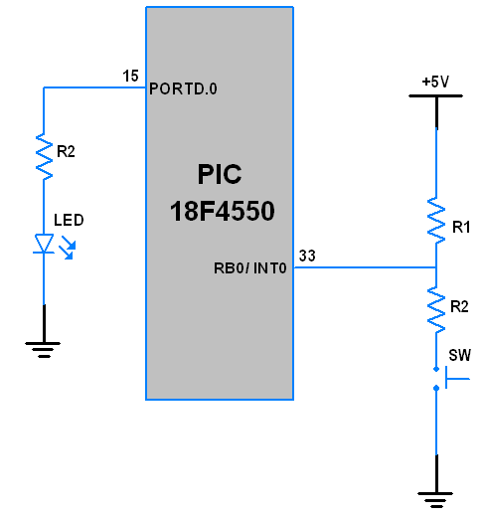
Example
A simple application in which we force the PIC18F4550 to enter into sleep mode or exit from sleep mode by using an External Interrupt.
Interfacing diagram
When the PIC18 MC is in
normal mode it will start blinking
the LED & by giving external
interrupt it will go into sleep mode
& the LED will stop blinking.
When the PIC18 MC is in
sleep mode, after providing external
interrupt it will wake up & start blinking
the LED again.

Slide 85
PIC18 Instruction Set
Includes 77 instructions: All Instructions are 2 or 4 bytes
–73 one word (16-bit) long &
–remaining 4 two words (32-bit) long
• Divided into seven groups
–Move (Data Copy) & Load
–Arithmetic
–Logic
–Program Redirection (Branch/Jump)
–Bit Manipulation
–Table Read/Write
–Machine Control

Slide 86
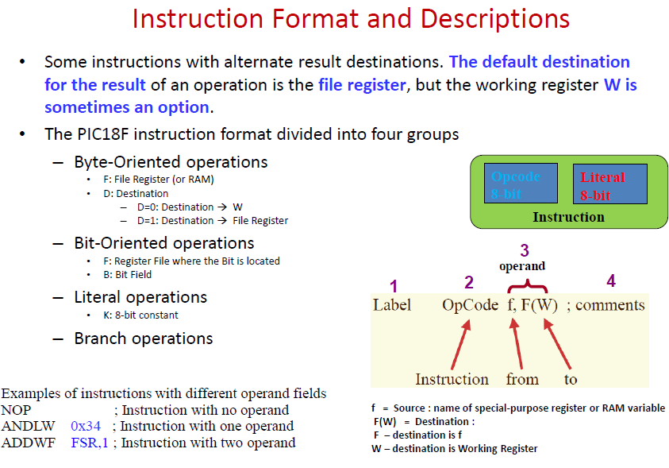

Slide 87
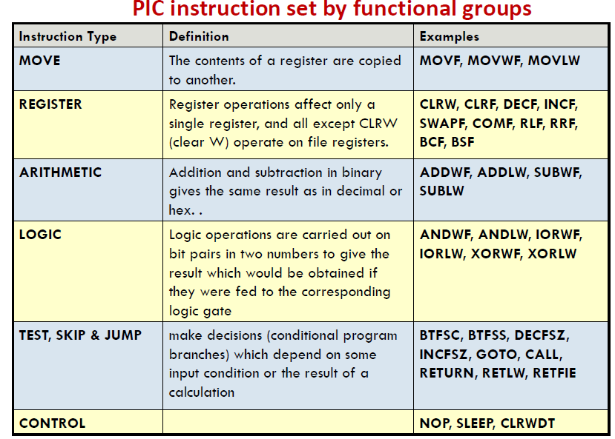

Slide 88
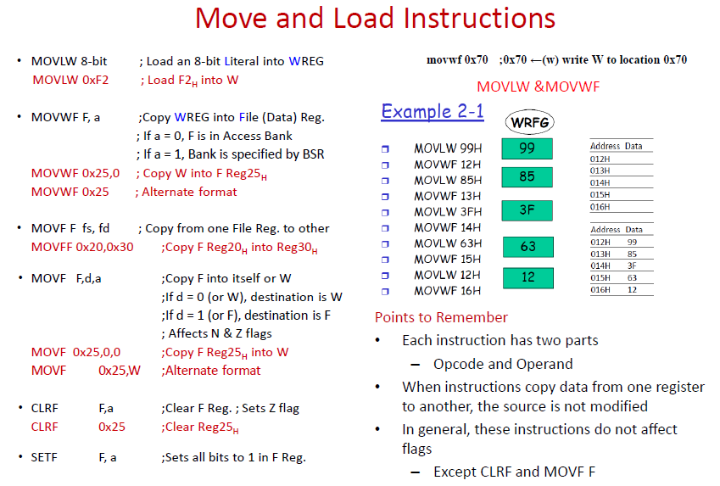

Slide 89
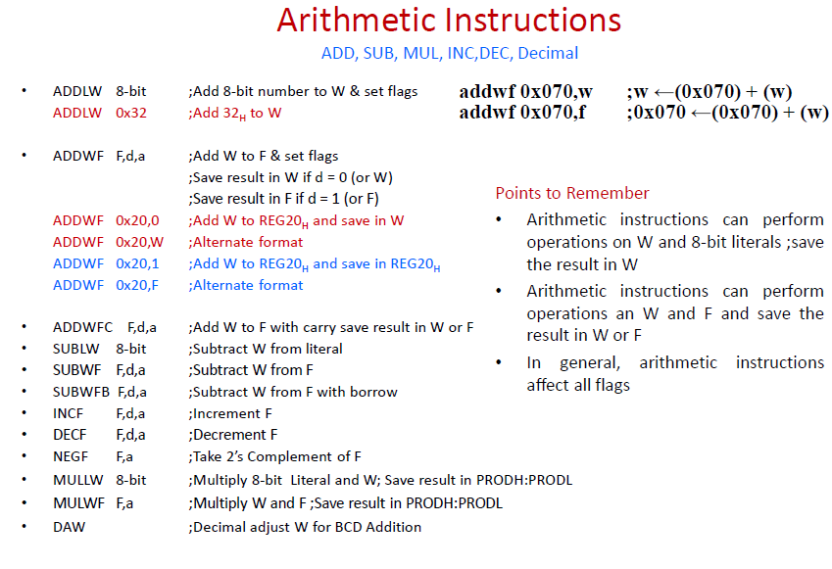

Slide 90
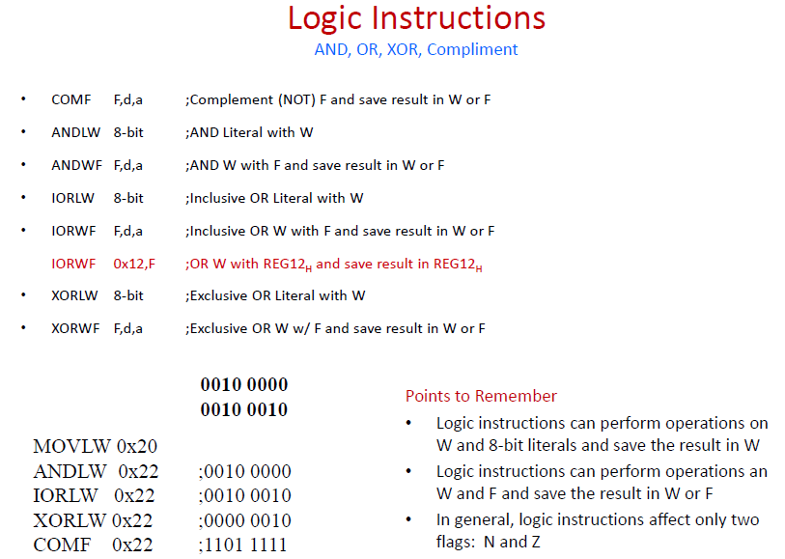

Slide 91
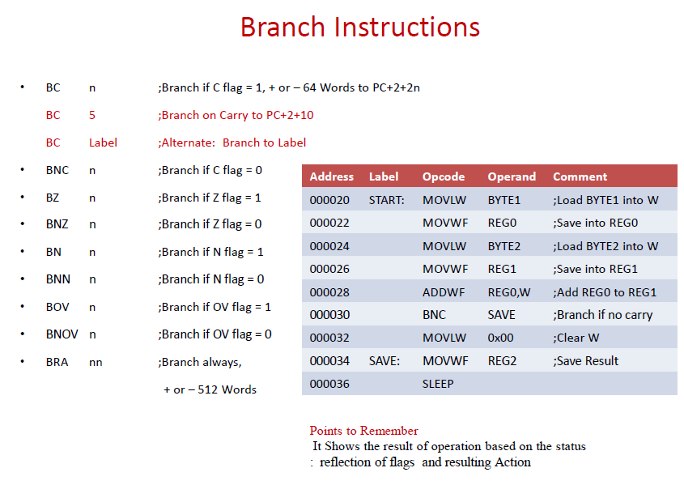

Slide 92
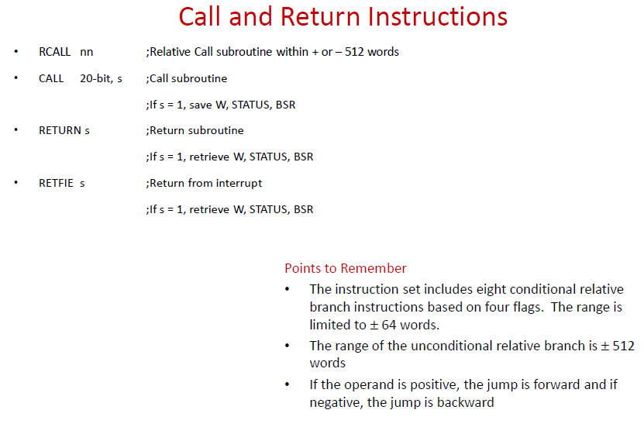

Slide 93
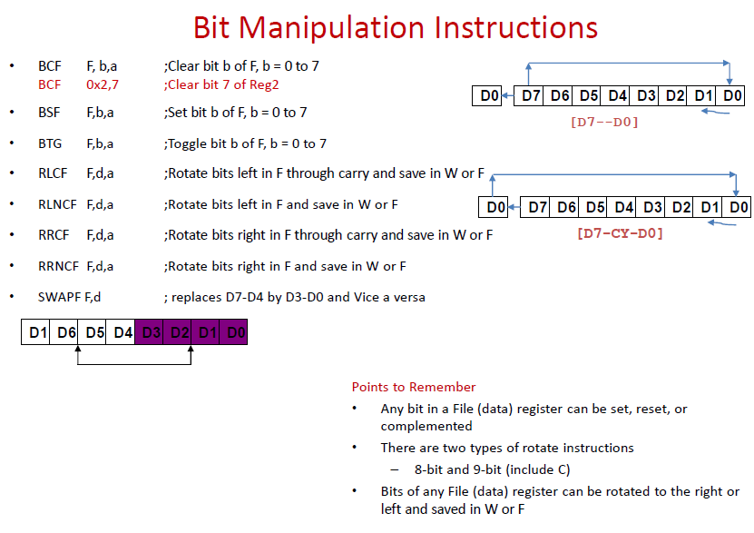

Slide 94
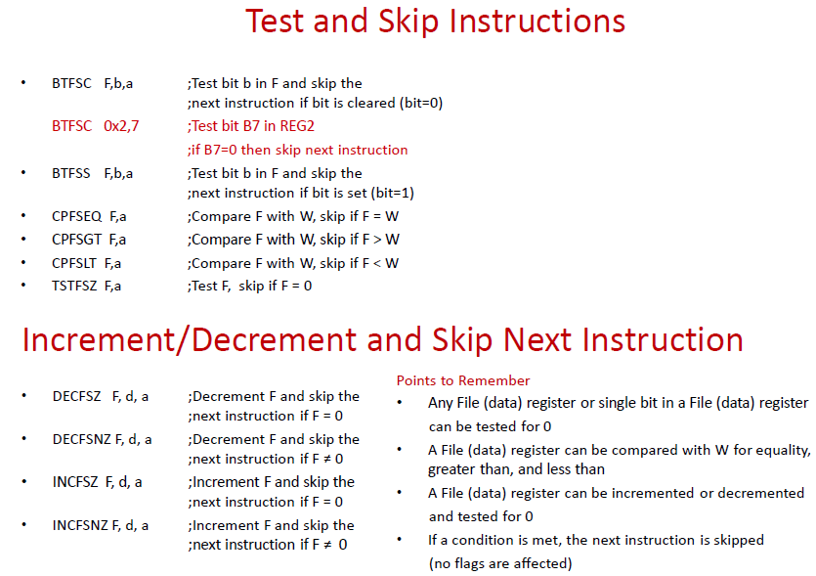

Slide 95
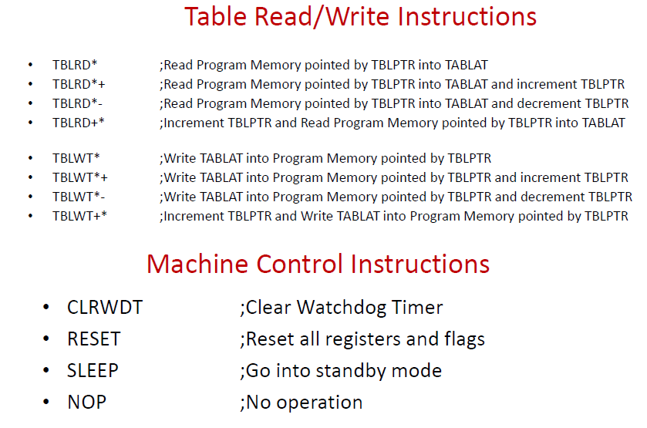

Slide 96
